Slide 1
TCP
CS 168 – Spring 2020 – Section 8

Slide 2
Agenda
Transmission Control Protocol (TCP)
Header
Connection handshake
Teardown handshake
Reliability

Slide 3
TCP
L4 Protocol (Transport)
Byte Stream
Bi-directional
Reliable
In-order
Source port
Destination port
Sequence Number number
Acknowledgment
HdrLen
0
Flags
Advertised window
Checksum
Urgent pointer
Options (variable)
Data
Notes:
UDP is message-oriented
Message Oriented protocols send data in distinct chunks or groups. Stream protocols send a continuous flow of data.

Slide 4
TCP Header
Host port numbers
Multiplexing and demultiplexing
16 bits
Source port
Destination port
Sequence number
Acknowledgment
HdrLen
0
Flags
Advertised window
Checksum
Urgent pointer
Options (variable)
Data

Slide 5
TCP Header
Byte offset
Of first payload byte
Initialized randomly
Byte Stream Protocol
Seq # refers to bytes
Source port
Destination port
Sequence number
Acknowledgment
HdrLen
0
Flags
Advertised window
Checksum
Urgent pointer
Options (variable)
Data
Notes:
If the SYN flag is set (1), then this is the initial sequence number. The sequence number of the actual first data byte and the acknowledged number in the corresponding ACK are then this sequence number plus 1.
If the SYN flag is clear (0), then this is the accumulated sequence number of the first data byte of this segment for the current session.
Bytes rather than packets

Slide 6
TCP Header
Cumulative ACKs
Seq # of next byte
Data packets carry ACKs
Source port
Destination port
Sequence number
Acknowledgment
HdrLen
0
Flags
Advertised window
Checksum
Urgent pointer
Options (variable)
Data

Slide 7
TCP Header
Header length
4 bits
In 4-byte words
Minimum 5 words (20B)
Maximum 15 words
Why?
Source port
Destination port
Sequence number
Acknowledgment
HdrLen
0
Flags
Advertised window
Checksum
Urgent pointer
Options (variable)
Data
Notes:
Only 4 bits, so max is 2^4 – 1 = 15 words
varying header length for options

Slide 8
TCP Header
SYN
SYNchronize initial state
ACK
ACKnowledgement
FIN
No more data
RST
Connection ReSeT
Source port
Destination port
Sequence number
Acknowledgment
HdrLen
0
Flags
Advertised window
Checksum
Urgent pointer
Options (variable)
Data
Notes:
9 bits
FIN says "i finished talking to you, but i'll still listen to everything you have to say until you're done"
RST says "there is no conversation. i won't say anything and i won't listen to anything you say
If the SYN flag is set (1), then this is the initial sequence number. The sequence number of the actual first data byte and the acknowledged number in the corresponding ACK are then this sequence number plus 1.
If the SYN flag is clear (0), then this is the accumulated sequence number of the first data byte of this segment for the current session.

Slide 9
TCP Header
Receive Window Size
Maximum receiver buffer
Limits sending rate
Don’t send faster than receiver can process
Source port
Destination port
Sequence number
Acknowledgment
HdrLen
0
Flags
Advertised window
Checksum
Urgent pointer
Options (variable)
Data
Notes:
unit: byte
limited to between 2 and 65,535 bytes.

Slide 10
TCP Header
Checksum
Includes header and payload
Options common
Unlike IP
Not covered
Assume no options unless specified
Source port
Destination port
Sequence number
Acknowledgment
HdrLen
0
Flags
Advertised window
Checksum
Urgent pointer
Options (variable)
Data

Slide 11
Connection Establishment

Slide 12
Connection Establishment
Sequence number and ACK number don’t start at zero
Instead client and server choose random initial seq #
Why?
Must be communicated between client and server
Notes:
Connection spoofing, connection resetting, and data injection

Slide 13
Connection Establishment
Client/Server exchange state
Initial Sequence numbers
Port number
TCP Options
TCP is full duplex!
A TCP connection between A and B can carry data in both directions
Packet can both carry data and ACK data
Notes:
example about TCP options:
- Maximum Segment Size (MSS)
- Selective Acknowledgements (SACK)

Slide 14
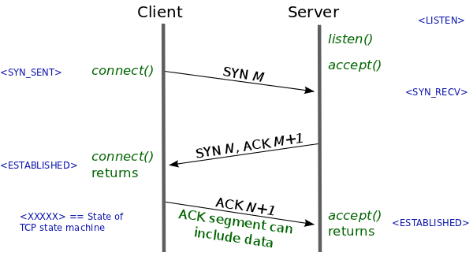
Three Way Handshake (1)
Client sends SYN
TCP packet, SYN flag set
Carries initial state
Receive window
Source port number
Initial sequence number

Slide 15
Three Way Handshake (2)
Server responds with a SYN-ACK
ACK the client’s SYN
Respond with the server’s own SYN
Carries server’s initial state
Receive window
Source port number
Initial sequence number

Slide 16
Three Way Handshake (3)
Client responds with an ACK
Now the connection is established!
Client and server can freely communicate

Slide 17
Teardown

Slide 18
Two Teardown Methods
Four way handshake (FIN)
Graceful/normal teardown
Reset (RST)
Exceptional teardown

Slide 19
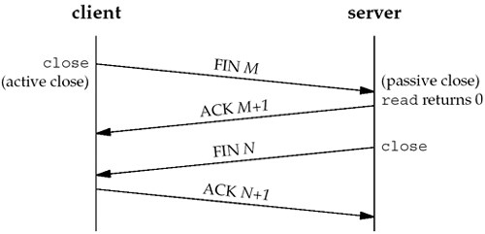
Normal Teardown (FIN)
One side closes their connection
Indicates they will send no more data
Sends a FIN
Receives an ACK
Other side may continue transmitting
Eventually it closes as well
Sends a FIN
Receives an ACK
Connection is closed
Notes:
could combine into three-way handshake

Slide 20
TCP Reset (RST)
Reset the connection
Most commonly, attempt to SYN on a closed port
Send RST packet(s) only (no ACK)
Notes:
If side that sent RST receives more packets, will resend the RST
what if receiving process dies? (eg segfault)

Slide 21
Reliability

Slide 22
Reliability
Cumulative ACKs
Allow detection of dropped packets
How do we know a packet was lost?
Timeout
Duplicate ACKs

Slide 23
Timeout
Retransmission Time Out (RTO)
Timeout after which packets are retransmitted
Based on a constantly updated RTT estimate (and variance)
Single timer (not per-packet)
Each received ACK of new data resets RTO
If RTO times out
Retransmit packet containing “next byte”
Notes:
exponential weighted moving average

Slide 24
Calculating Timeout
Retransmission Time-Out (RTO): actual timer value
We set this value!
How do we find the best timeout value? Must estimate...
Estimated Time-Out (ETO)
ETO = Estimated RTT + 4 · Estimated Deviation
Things change! Update our estimates over time via...
Deviation = |Estimated RTT − Sample RTT|
Estimated = α · Estimated + (1−α) · Sampled
Notes:
exponential weighted moving average

Slide 25
Setting RTO
When clean sample arrives,
Set RTO = ETO
When RTO timer expires,
Set RTO = 2 · ETO
Note: this is not the law! Just one way to set a “good” timeout value based on real life data.
Notes:
exponential weighted moving average

Slide 26
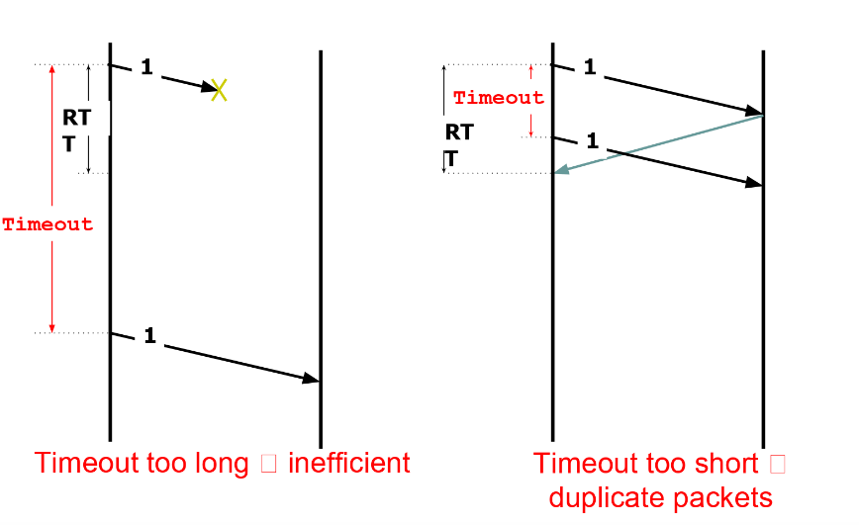
Timeout

Slide 27
Duplicate ACKs
Transmit
Seq 1000
Seq 2000
Seq 3000 Dropped in flight
Seq 4000
Seq 5000
Seq 6000
What ACKs do we receive?
ACK 2000
ACK 3000
(nothing)
ACK 3000
ACK 3000
ACK 3000
Duplicate ACKs indicate packet loss / reorder

Slide 28
Worksheet

Slide 29
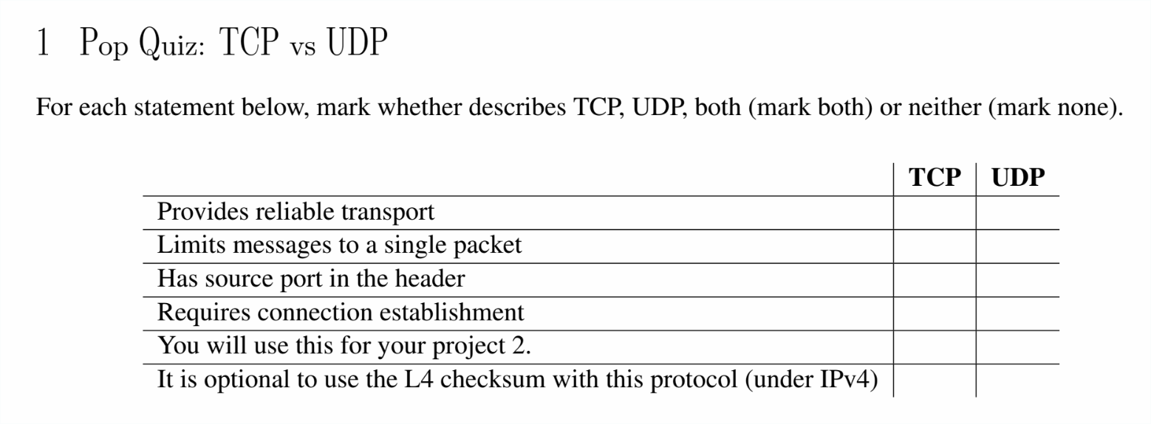
Q1

Slide 30
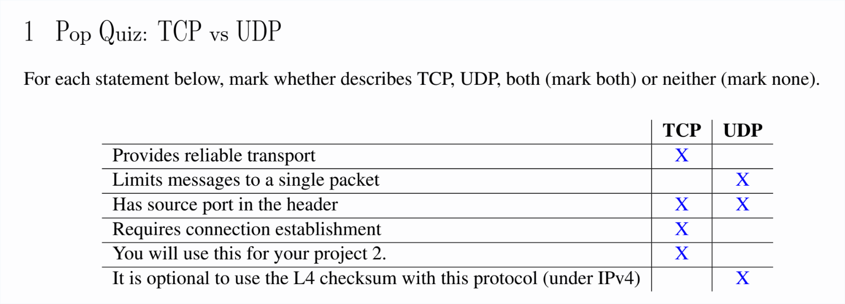
Q1

Slide 31
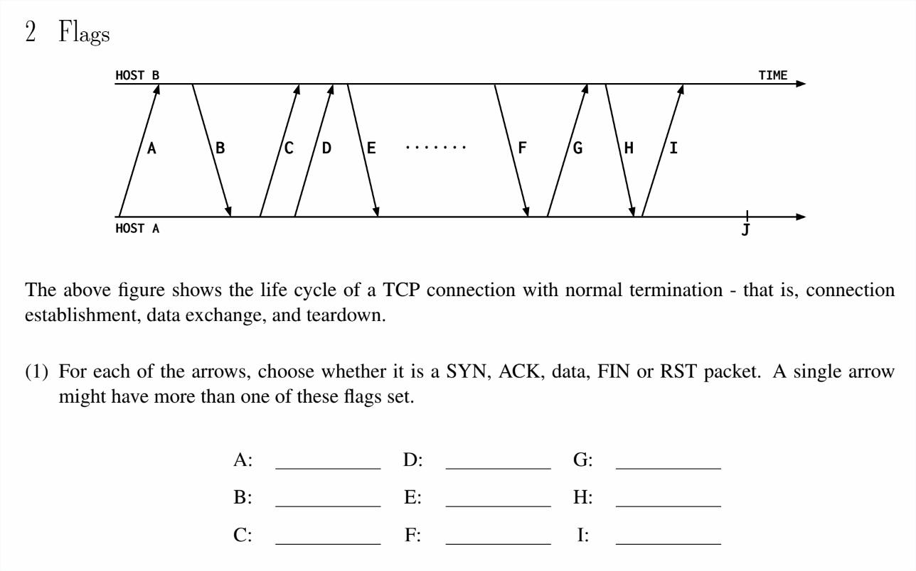
Q2.1

Slide 32
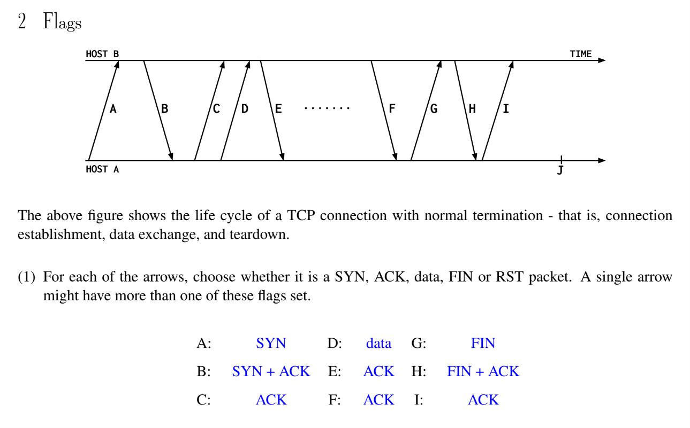
Q2.1

Slide 33
Q2.2

Slide 34
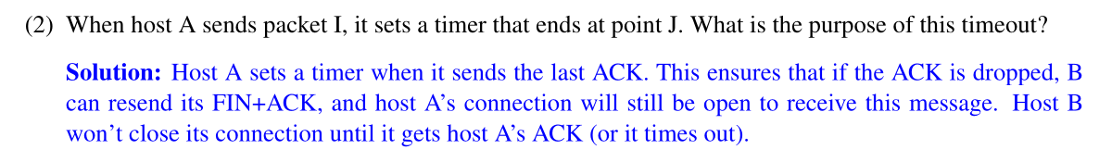
Q2.2

Slide 35
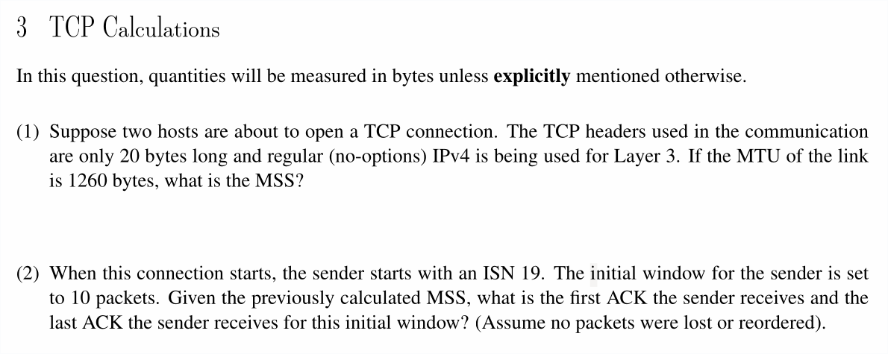
Q3.1 & 3.2

Slide 36
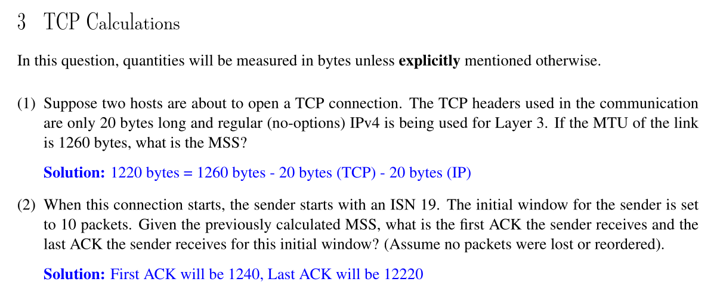
Q3.1 & 3.2

Slide 37
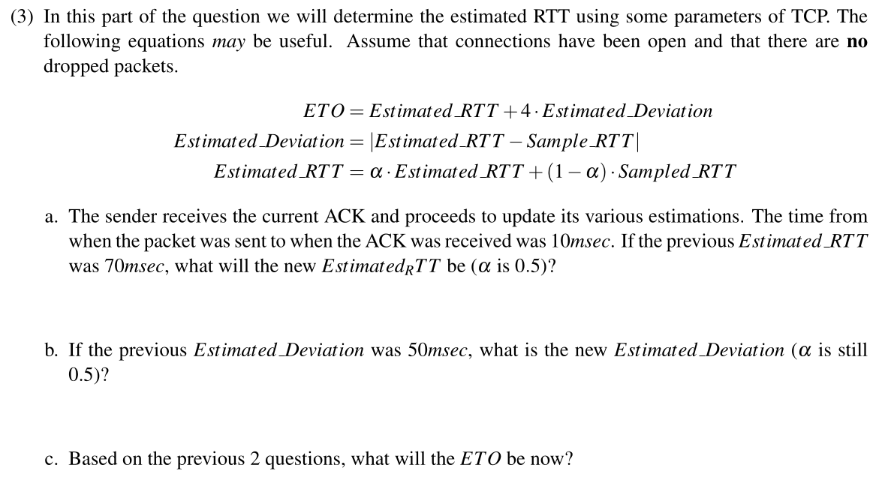
Q3.3

Slide 38
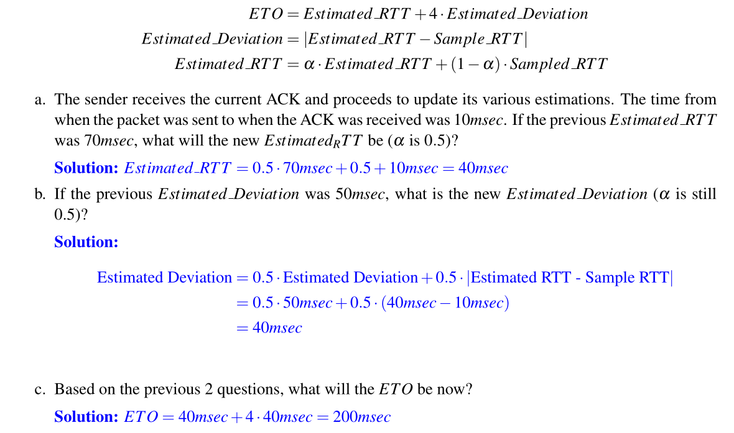
Q3.3

Slide 39
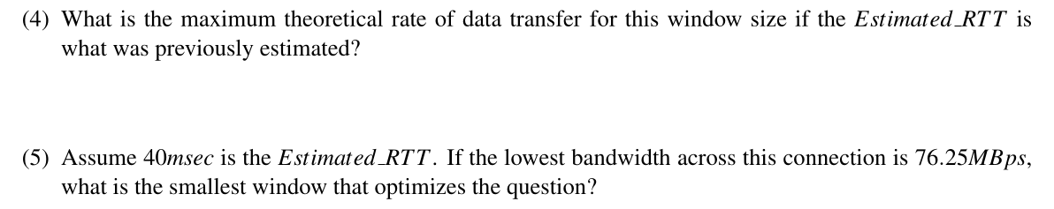
Q3.4 & 3.5

Slide 40
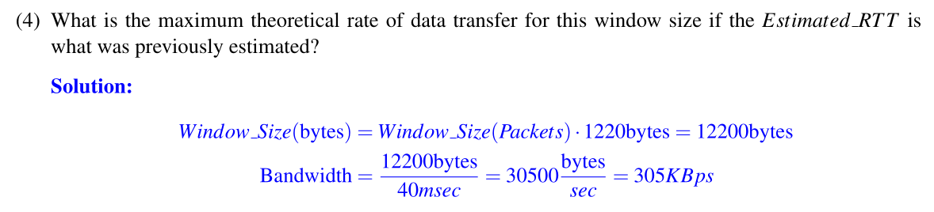
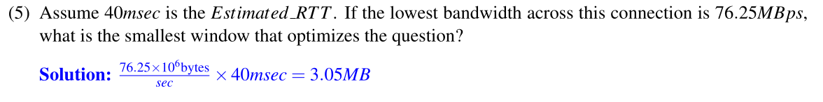
Q3.4 & 3.5

Slide 41
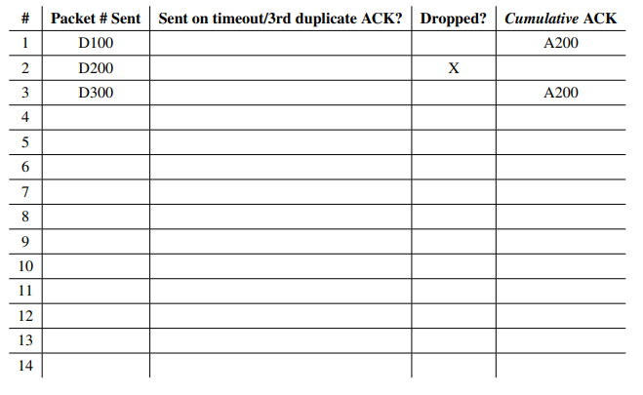
Q4.1
D400
A200
D200
X
A500
D500
A600
D600
A700
D700
X
D800
A700
D900
A700
D700
X
A1000
D1000
A1100

Slide 42
Q4.2
D100
D200
D300
X
A200
1 RTT
A200
D400
Timer start (A200)
A200
TO
.
.
.
D200
Time-out! Retransmit
1 RTT
A500
Notes:
Note: there is no transmission delay, so D100, 200, 300 are sent at the same time. We just separated them here to follow convention of previous diagrams. That’s why it only takes 1 RTT for both A200s to get back, and the timer starts when they both get back.
Note: timer starts on every new ACK received.

Slide 43
Q4.2
D500
D600
D700
1 RTT
X
A600
A700
D800
Timer start (A700)
D900
A700
A700
TO
.
.
.
D700
Time-out! Retransmit
1 RTT
A1000

Slide 44
Q4.2
D1000
1 RTT
A1100
Total Time = RTT + TO + RTT + RTT + TO + RTT + RTT
= 5 * RTT + 2 * TO
= 6.05 seconds

